Slide 1



APANATIME TECHNOLOGY PVT.LTD
Supply Chain Management
Presented by,
Arihant Jain
Batch No: ATDA2501
Mentors:
1. Anish Kumar
2. Abhishek Ray
Project

Slide 2

APANATIME TECHNOLOGY PVT.LTD
At Apana Time , we believe in the transformative power of education. Our mission is to unlock the potential of every learner, empowering them to achieve their dreams and make a positive impact on the world.
Apana Time is a data-driven firm specializing in tailored analytics solutions for businesses looking to unlock actionable insights from their data. We combine expertise in Data Analysis, Power BI Development, and Python to create dynamic, insightful dashboards that empower our clients to make informed decisions and drive growth.
Our dedicated team leverages the latest tools and techniques to analyze complex datasets, build custom visualizations, and deliver intuitive, interactive dashboards. We pride ourselves on understanding each client’s unique data needs and translating them into clear, impactful insights.
Let us help you turn your data into a competitive advantage with solutions that are efficient, scalable, and directly aligned with your business goals.

Slide 3

C O N T E N T S
Business Objective
Business Constraints
Project Architecture
Data Collection
Exploratory Data Analysis
Data Visualization

Slide 4
Business Problem
Our company is experiencing inefficiencies in supply chain management, resulting in delayed deliveries , inventory
imbalances (excess stock in some warehouses and shortages in others), higher operational costs , and reduced customer satisfaction.

Slide 5
Project Overview and Scope
The primary objective of this project is to address and resolve operational inefficiencies in the company’s supply chain management. Current challenges include delayed deliveries, inventory imbalances across various warehouse locations, inflated operational costs, and decreasing customer satisfaction levels. Through a data-driven approach, the project aims to enhance the overall efficiency of the supply chain by leveraging data analytics tools such as Python, SQL, and Power BI.
The outcome will be a comprehensive Supply Chain Analytics Dashboard to support informed decision-making and improve key performance metrics.

Slide 6
Project Scope
Data Cleaning & Preprocessing
SQL-Based Analytical Insights
Inventory Optimization
Delivery Route Optimization
Demand Forecasting
Power BI Dashboard Development

Slide 7
Data Dictionary
The dataset contains the following columns:
Warehouse_ID – Unique identifier for each warehouse.
Location – Geographic area where the warehouse is situated.
Current_Stock – Quantity of products currently available in stock.
Demand_Forecast – Predicted future demand for products.
Lead_Time_Days – Number of days it takes for new stock to arrive
Shipping_Time_Days – Time taken to ship products to customers.
Stockout_Risk – Probability of running out of stock.
Operational_Cost – Total cost to run the warehouse operations.
Supplier_ID – ID of the supplier providing products.
Product_Category – Classification of products by type.

Slide 8
Monthly_Sales – Total sales from the warehouse per month.
Order_Processing_Time – Time taken to process an order.
Return_Rate – Percentage of sold products returned by customers.
Customer_Rating – Average rating given by customers.
Warehouse_Capacity – Maximum stock the warehouse can hold.
Storage_Cost – Expense for storing goods in the warehouse.
Transportation_Cost – Cost of delivering products to customers.
Backorder_Quantity – Number of orders pending due to stock unavailability.
Damaged_Goods – Quantity of goods damaged during storage or handling.
Employee_Count – Number of employees working in the warehouse.

Slide 9
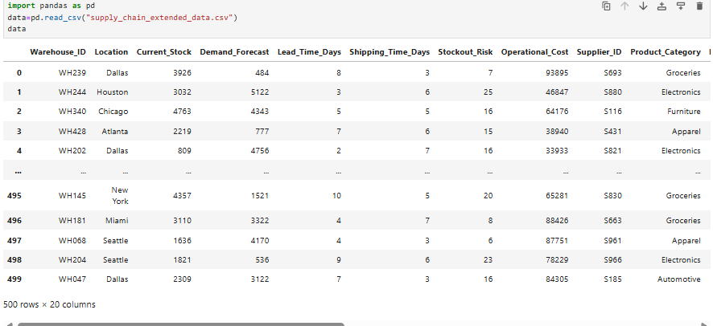
DATA Preprocessing

Slide 10
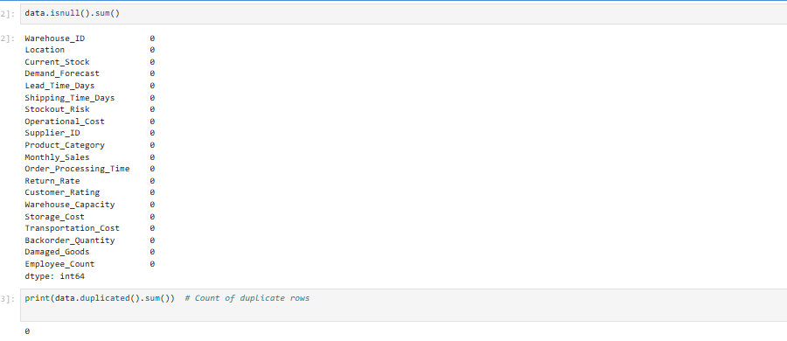
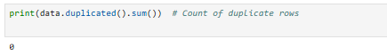

Slide 11
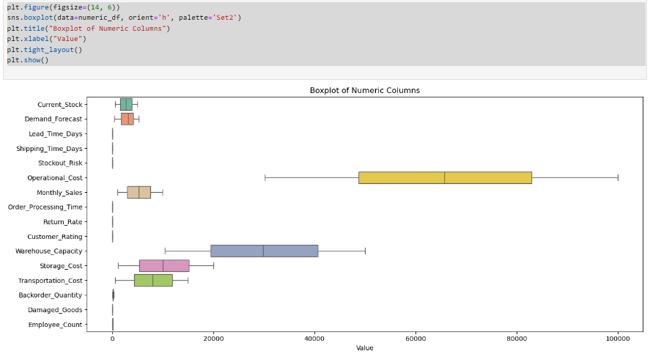

Slide 12
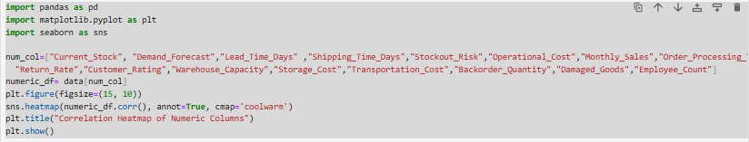

Slide 13
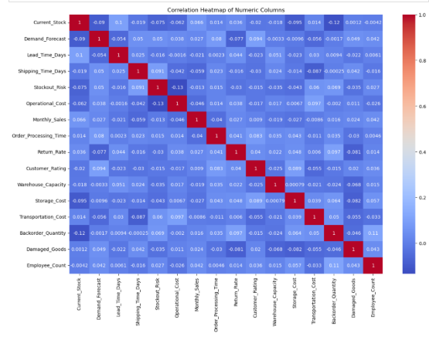

Slide 14



EDA

Slide 15
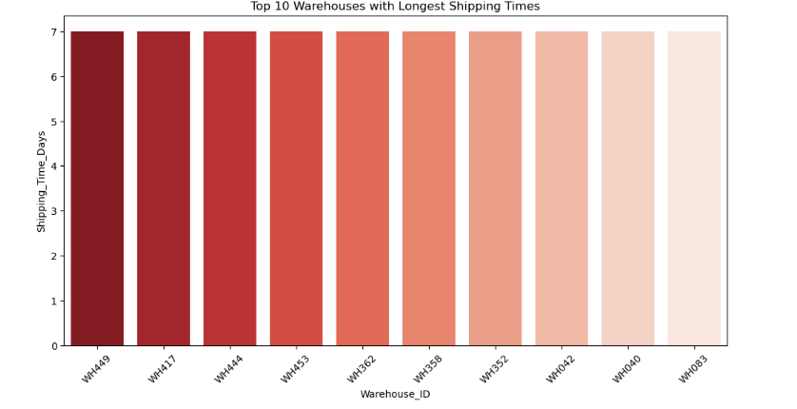
Exploratory Data Analysis [EDA]
Identify the top 10 warehouses with the Longest Shipping Times.

Slide 16
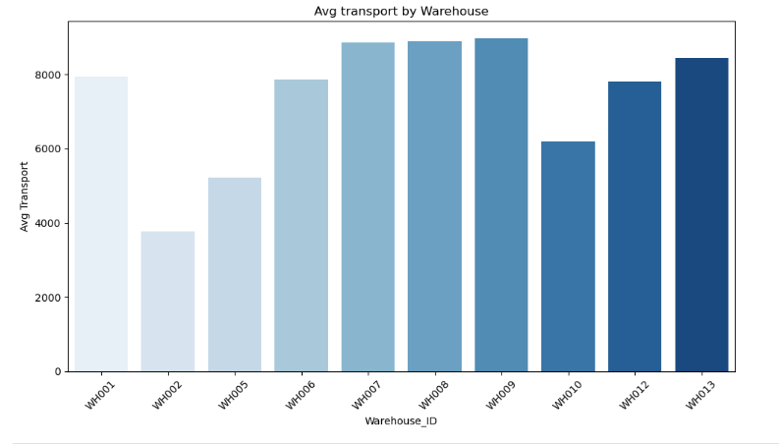
Identify the top 10 warehouses with the Avg transportation costs.

Slide 17
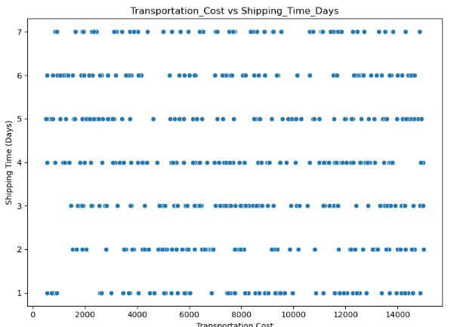
Relationship between Transportation cost and shipping days

Slide 18
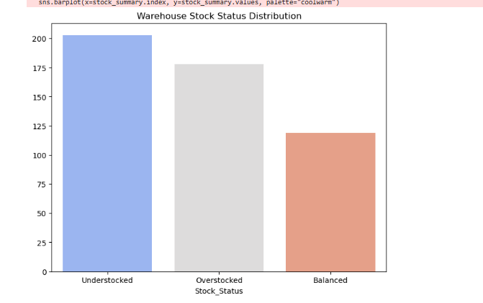
Warehouse stock status Distribution

Slide 19
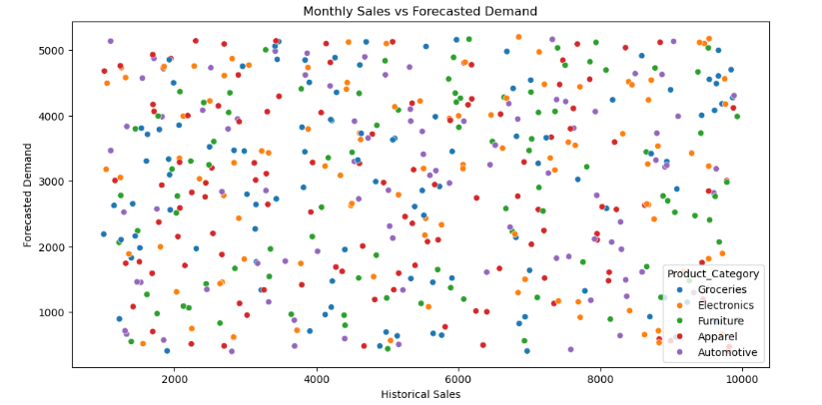
Relationship between Monthly Sales and Forecast Demand

Slide 20
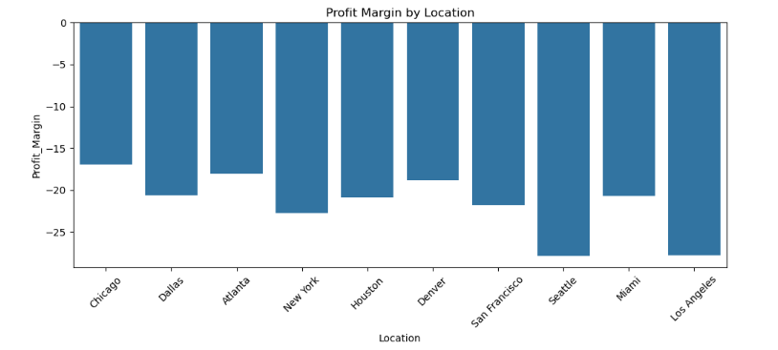
Profit According to location

Slide 21
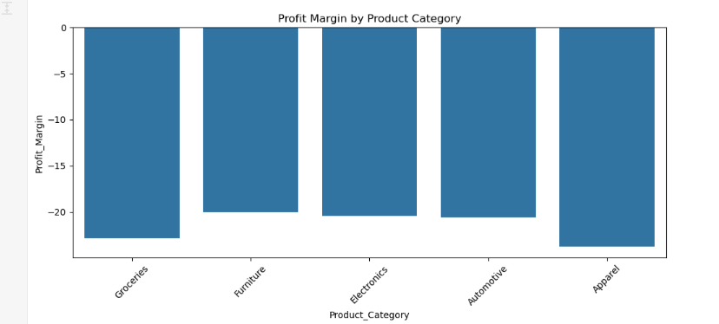
Profit According to product Category

Slide 22
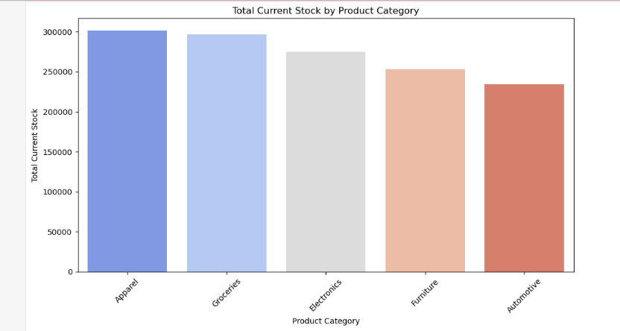
Total Current Stock by Product Category

Slide 23
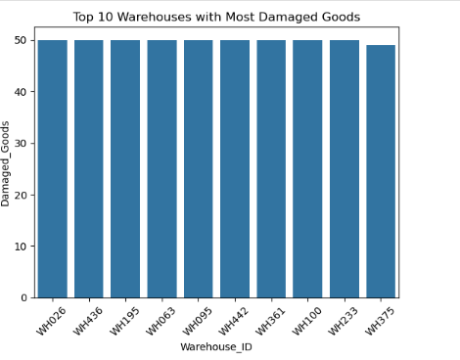
Top 10 Warehouses with Most Damaged Goods

Slide 24
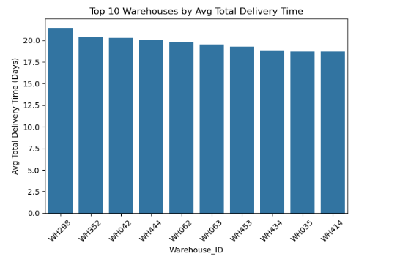
Top 10 Warehouses by Avg Total Delivery Time

Slide 25
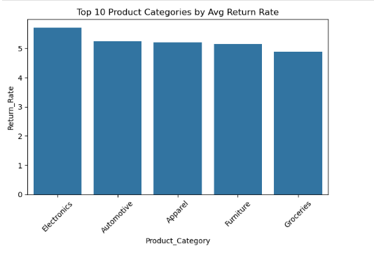
Top 10 Product Categories by Avg Return Rate

Slide 26
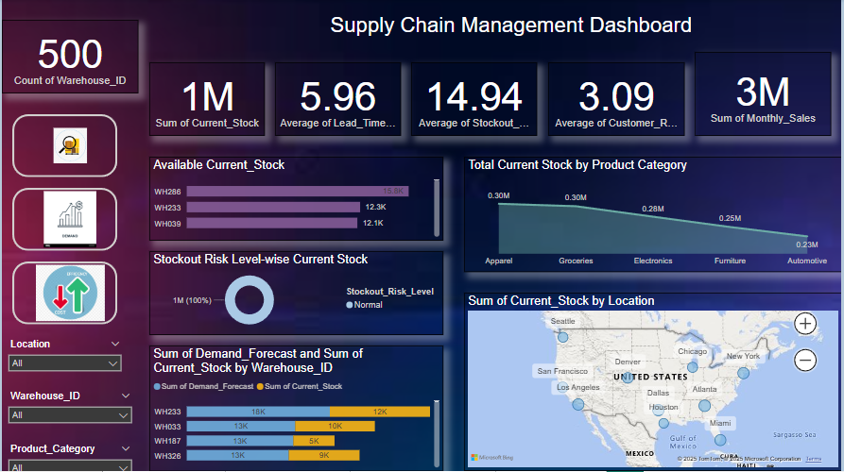
Data Visualization

Slide 27
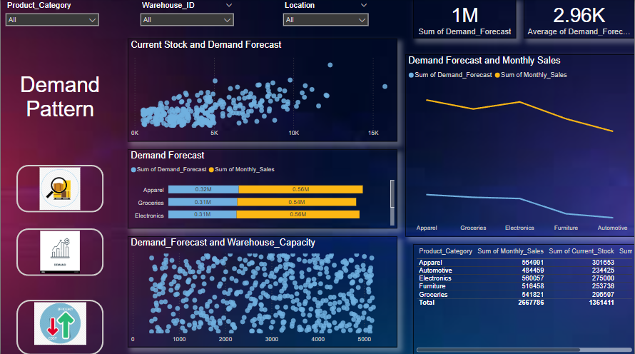

Slide 28
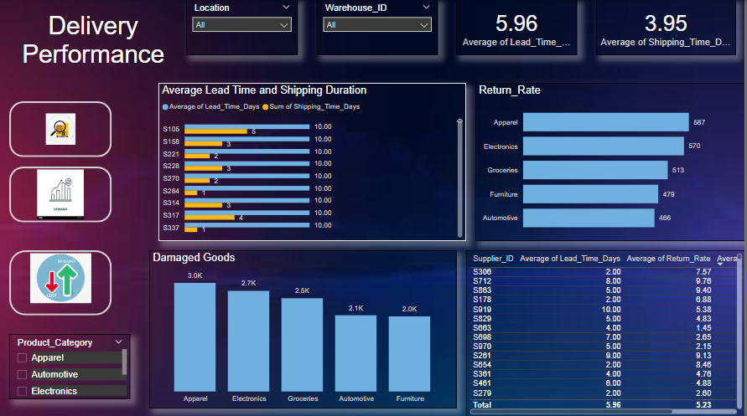

Slide 29
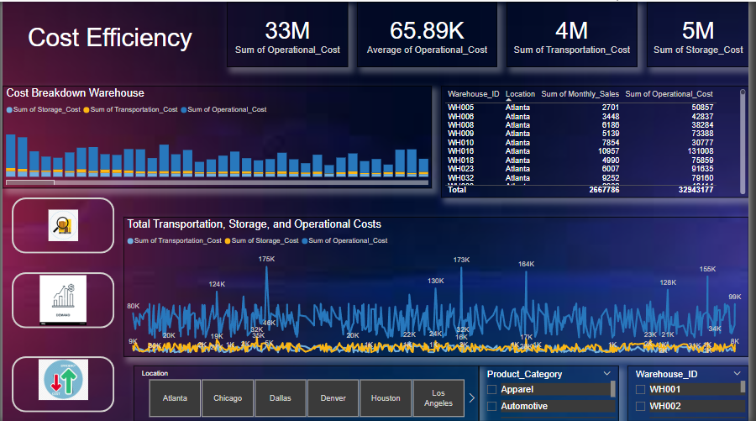

Slide 30

THANK YOU
ARIHANT JAIN
jainarihant0102@gmail.com

